Slide 1

Leaf nitrogen is driven by net costs of resource use in Texan grasslands
Evan A. Perkowski; Nicholas G. Smith
@EvanPerkowski

Slide 2
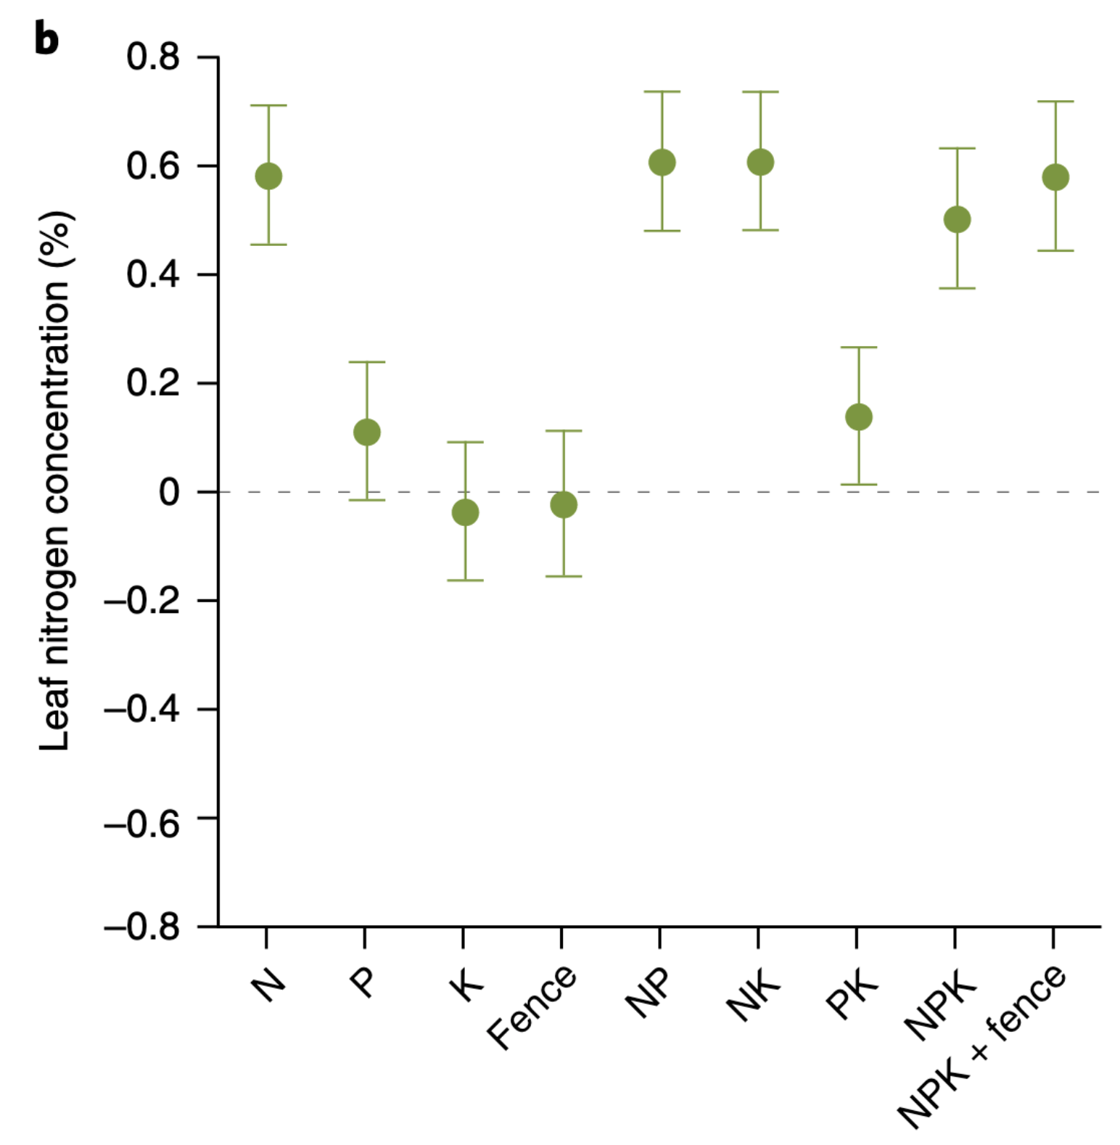
Soil nitrogen generally increases leaf nitrogen
@EvanPerkowski
Firn et al. (2019) Nature
Notes:
Soil nitrogen has been shown to positively influence leaf nitrogen in a fair share of studies.
This figure is from a study by Jenn Firn in 2019 using a globally coordinated nutrient addition experiment by the name Nutrient Network.
In these experiments, nitrogen, phosphorus, and potassium are added in a full-factorial field manipulation in grassland systems
On the x-axis is the different combinations of nutrient additions, and on the y-axis is leaf nitrogen concentrations

Slide 3
Soil nitrogen generally increases leaf nitrogen
Plots that receive nitrogen have higher leaf nitrogen content
@EvanPerkowski
Firn et al. (2019) Nature
Notes:
You can see that there is a pretty obvious increase in leaf nitrogen content in plots that receive nitrogen fertilizer regardless of potassium and phosphorus combinations

Slide 4
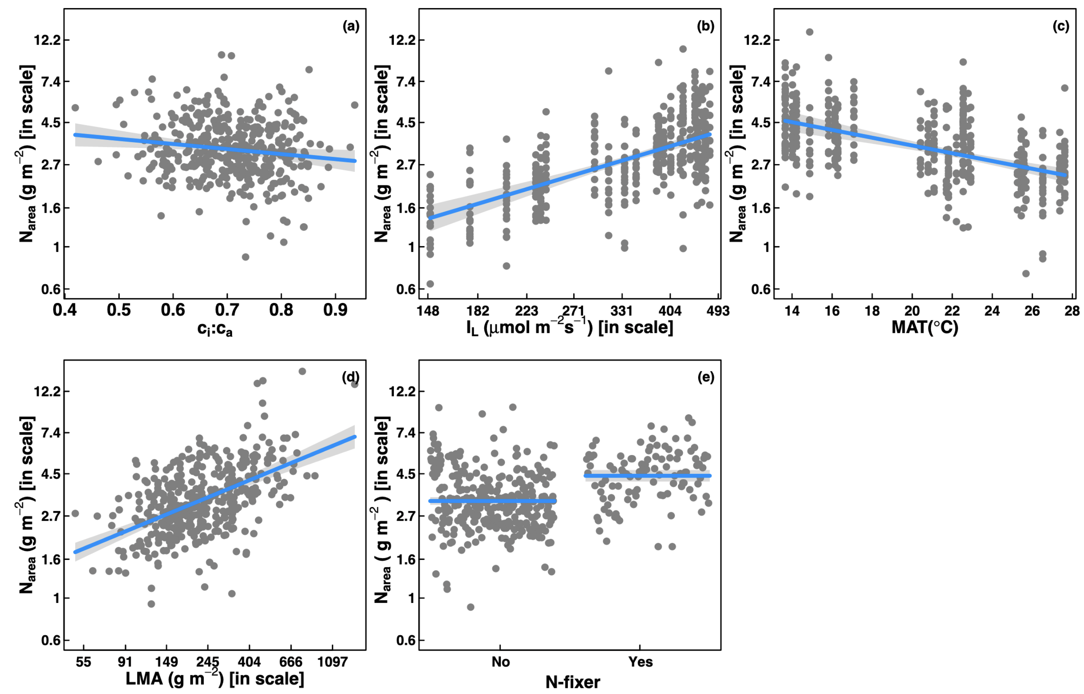
… but leaf nitrogen can be predicted independent of soil nitrogen
@EvanPerkowski
Dong et al. (2017) Biogeosciences
Notes:
Some recent work has also shown that leaf nitrogen can be predicted independent of soil nitrogen availability
This is work from Ning Dong showing on the top row in panel b and c that leaf nitrogen can be predicted from photosynthetically active radiation, which is basically light, and mean annual temperature.
Additionally, they show in panel a that leaf nitrogen can be predicted by the ratio of intercellular carbon dioxide to extracellular carbon dioxide, or Ci:Ca,
In panel d, they show that leaf nitrogen can be predicted through the ratio of intercellular carbon dioxide to atmospheric carbon dioxide, and in panel e show that leaf nitrogen can be predicted on the basis of whether a species can associate with nitrogen-fixing bacteria
Thus, aboveground climate and leaf traits can be used to predict patterns of leaf nitrogen

Slide 5
Leaf N is likely a product of interactions between climatic and edaphic factors
@EvanPerkowski
Notes:
While we know that variation in leaf nitrogen can be explained by soil nitrogen availability, climate, or plant traits, we still do not have a firm grasp of what drives leaf nitrogen content.
It is possible that these patterns are driven by plant allocation responses to soil nitrogen and climate, but we lack data that links these responses to physiological processes that range from the leaf to whole plant level
Yet, we do not fully understand when and where soil nitrogen impacts nitrogen allocation to leaf tissue vs. other tissues

Slide 6
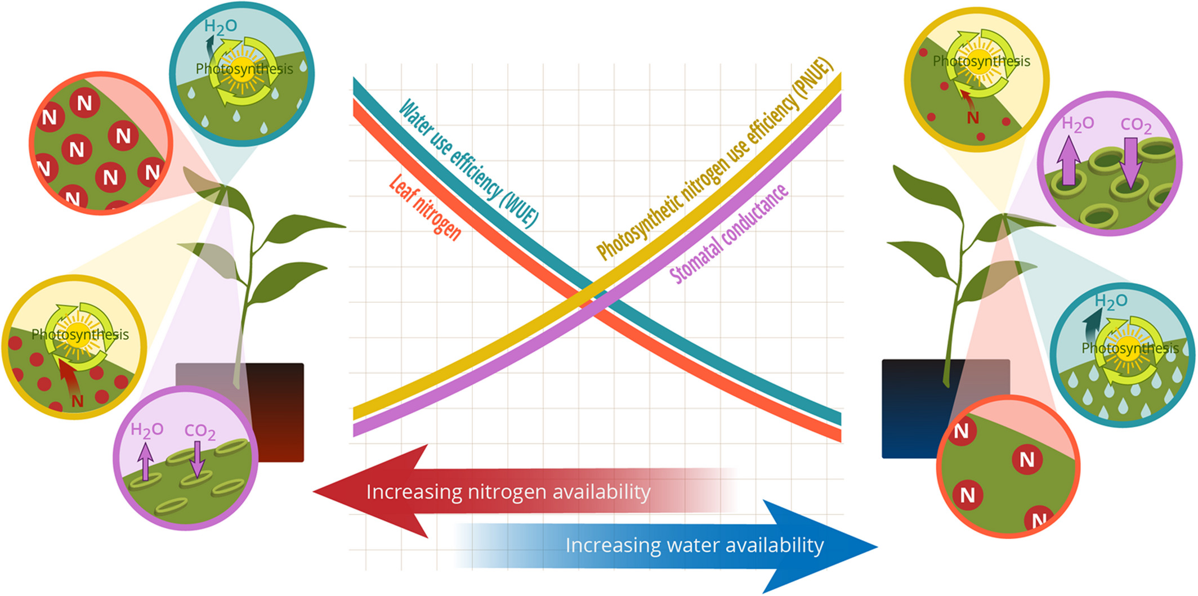
Photosynthetic ‘least-cost’ theory: leaves acclimate to changing climatic and edaphic environments via summed cost of resource use
@EvanPerkowski
Bialic-Murphy et al. (2021) Ecology Letters
Notes:
At the leaf level, plants might allocate nitrogen to photosynthetic leaf tissue in order to preserve water
This option can be explained through recent frameworks suggesting that plants can and should maximize photosynthetic carbon gain by trading inefficient use of an abundant resource for efficiency a more limited limiting resource.
For example, if nitrogen is relatively more available than water, then plants can maintain a similar photosynthetic output by increasing nitrogen allocation toward photosynthetic leaf tissue in order to increase water-use efficiency., effectively employing a water-savings mechanism
We might expect these patterns would be observed in arid systems where water is relatively less available than nitrogen, although these patterns haven’t necessarily been tested in temperate regions

Slide 7
Photosynthetic ‘least-cost’ theory: leaves acclimate to changing climatic and edaphic environments via summed cost of resource use
@EvanPerkowski
Bialic-Murphy et al. (2021) Ecology Letters
Notes:
At the leaf level, plants might allocate nitrogen to photosynthetic leaf tissue in order to preserve water
This option can be explained through recent frameworks suggesting that plants can and should maximize photosynthetic carbon gain by trading inefficient use of an abundant resource for efficiency a more limited limiting resource.
For example, if nitrogen is relatively more available than water, then plants can maintain a similar photosynthetic output by increasing nitrogen allocation toward photosynthetic leaf tissue in order to increase water-use efficiency., effectively employing a water-savings mechanism
We might expect these patterns would be observed in arid systems where water is relatively less available than nitrogen, although these patterns haven’t necessarily been tested in temperate regions

Slide 8
Species identity may determine leaf responses to shifts in soil resource availability
@EvanPerkowski

Slide 9
Soil resource availability
H₂O
Net cost of resource acquisition
H₂O
Water use efficiency
Leaf nitrogen
N
N
N
@EvanPerkowski

Slide 10
Study sites, collection methods, traits
22 Texan grassland sites
14 in 2020
15 in 2021 (5 similar to 2020)
3 leaves of 5 most dominant species at each site
Leaf N
Leaf water use efficiency
Composite soil sample
[NO₃-N]
[map]
@EvanPerkowski

Slide 11
Study sites, collection methods, traits
24 grassland sites
12 in 2020
15 in 2021 (3 same from 2020)
3 leaves of 5 most dominant species at each site
Leaf N
Leaf water use efficiency
Composite soil sample
[NO₃-N]

Slide 12
Leaf, soil, and climate measurements
3 leaves of 5 most dominant species at each site
Leaf N
Leaf water use efficiency
Composite soil sample
[NO₃-N]
Daily precipitation totals, mean temperature and VPD data from PRISM
@EvanPerkowski

Slide 13
Soil resource availability
H₂O
Net cost of resource acquisition
H₂O
Water use efficiency
Leaf nitrogen
N
N
N
@EvanPerkowski

Slide 14
Soil resource availability
H₂O
Net cost of resource acquisition
H₂O
Water use efficiency
Leaf nitrogen
N
N
N
@EvanPerkowski

Slide 15
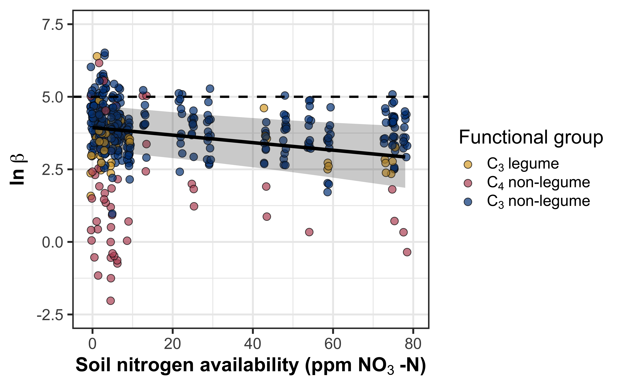
Soil nitrogen availability decreases the net cost of resource acquisition
Net cost of
resource acquisition
@EvanPerkowski

Slide 16
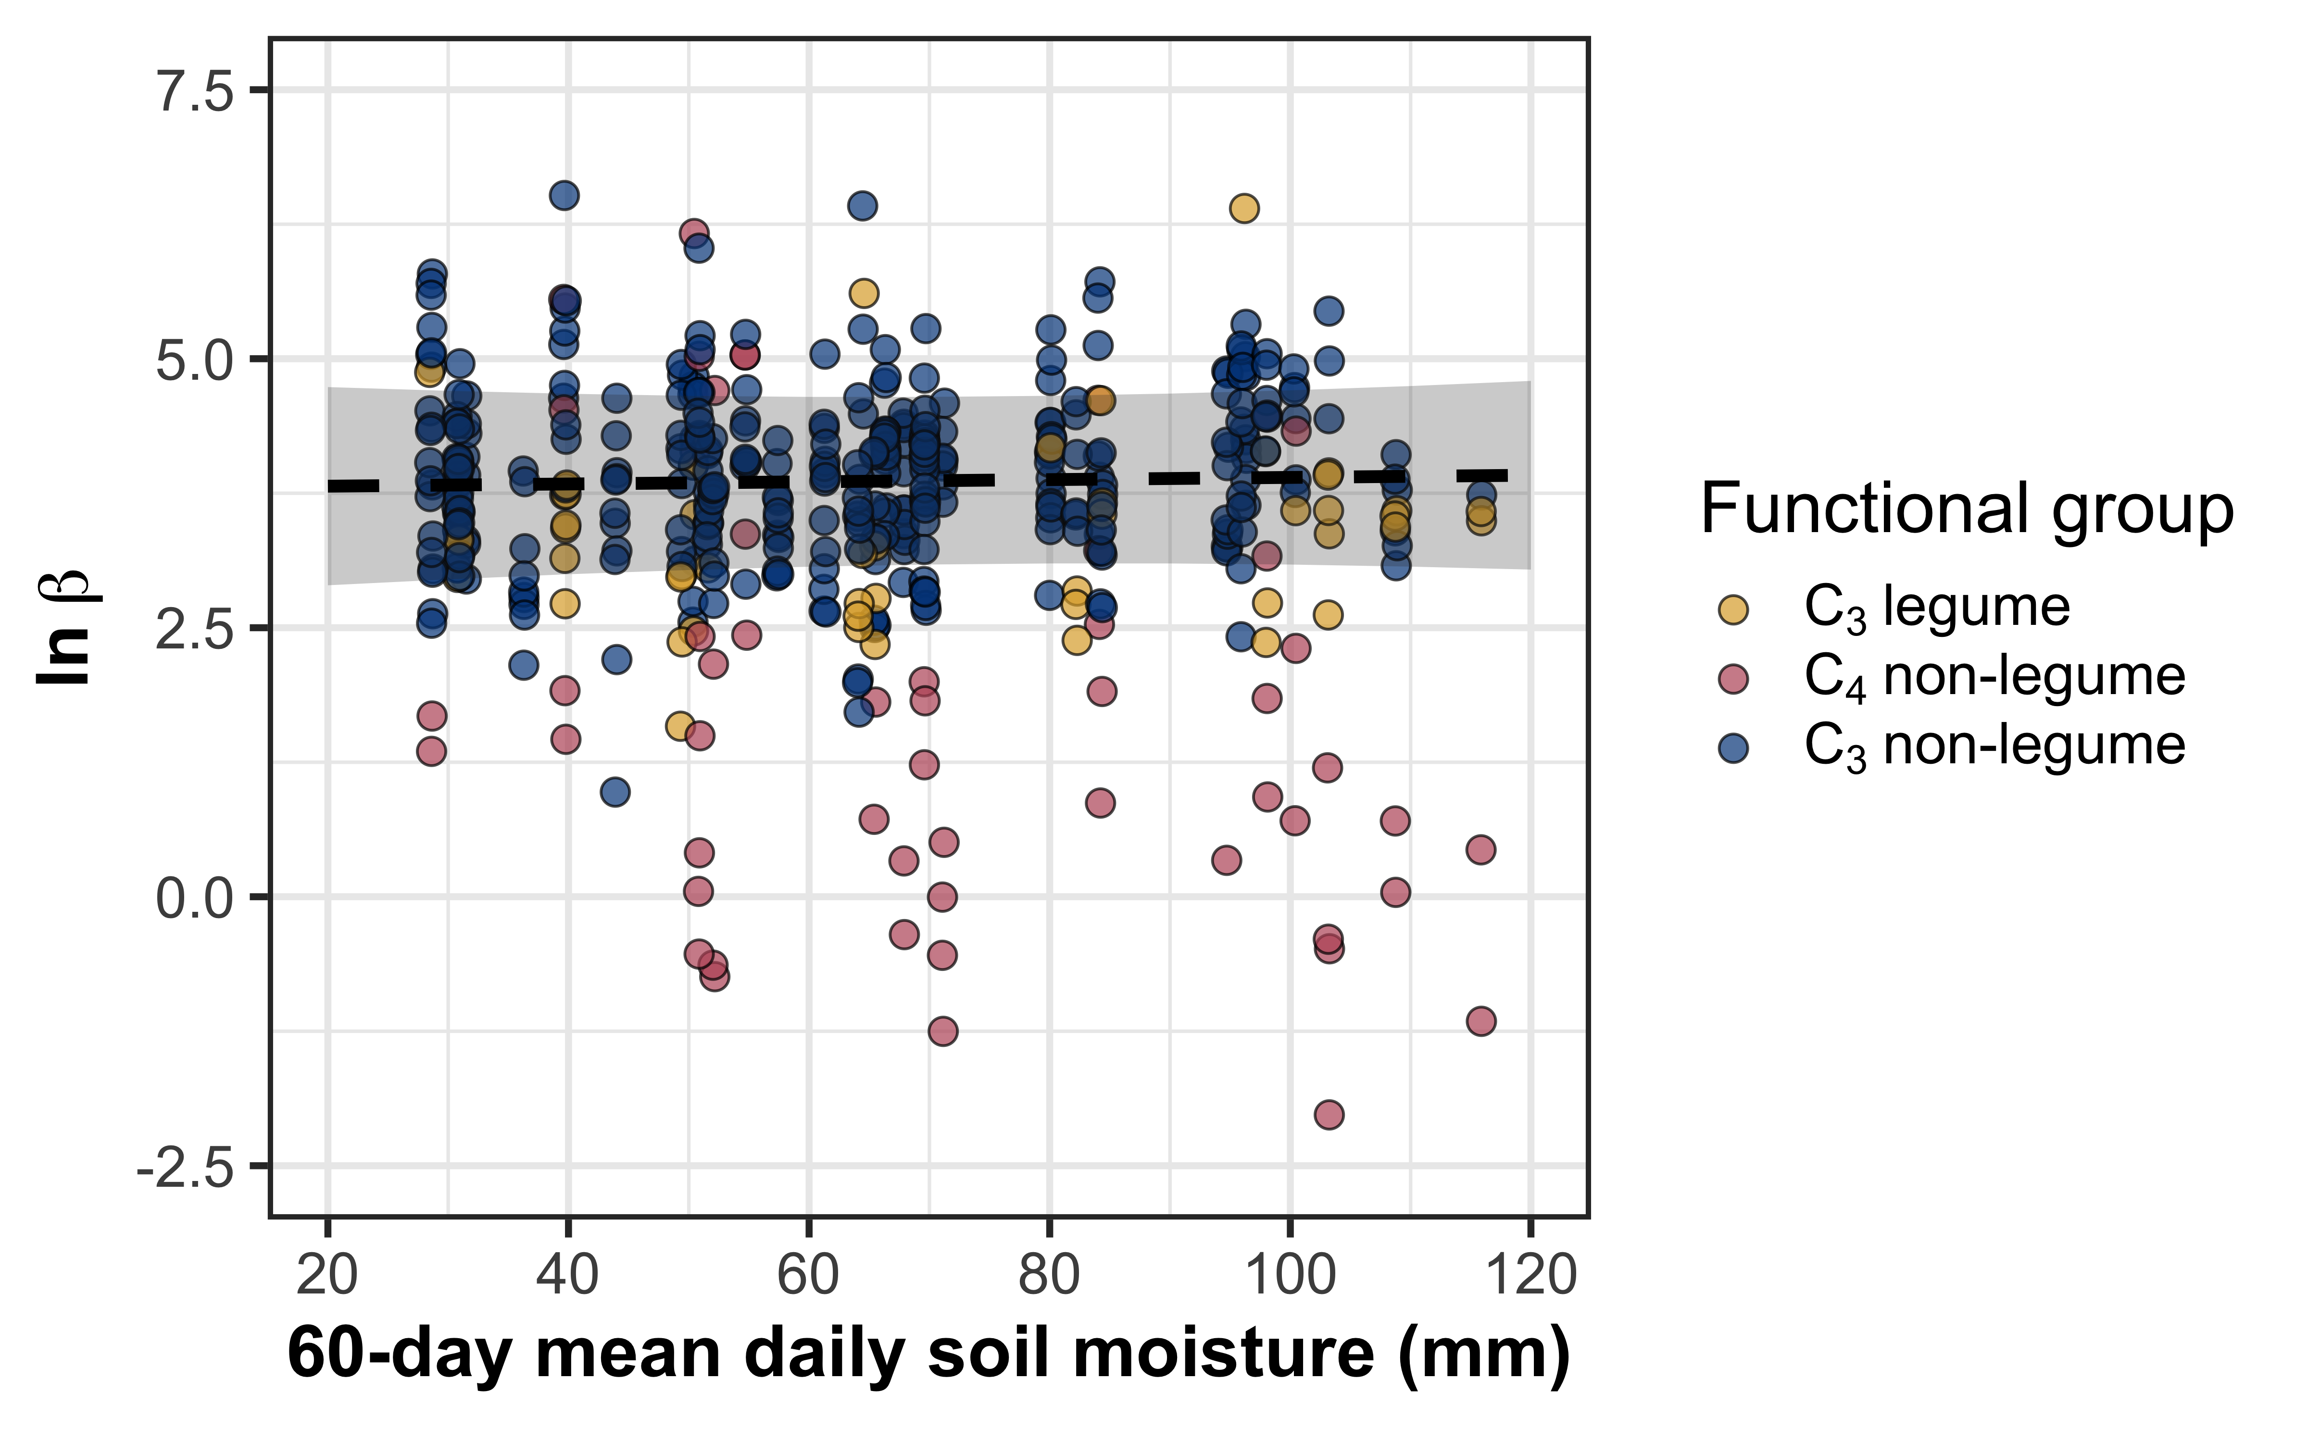
Soil moisture does not change the net cost of resource acquisition across species, except in C₄ non-legumes
Net cost of
resource acquisition
@EvanPerkowski

Slide 17
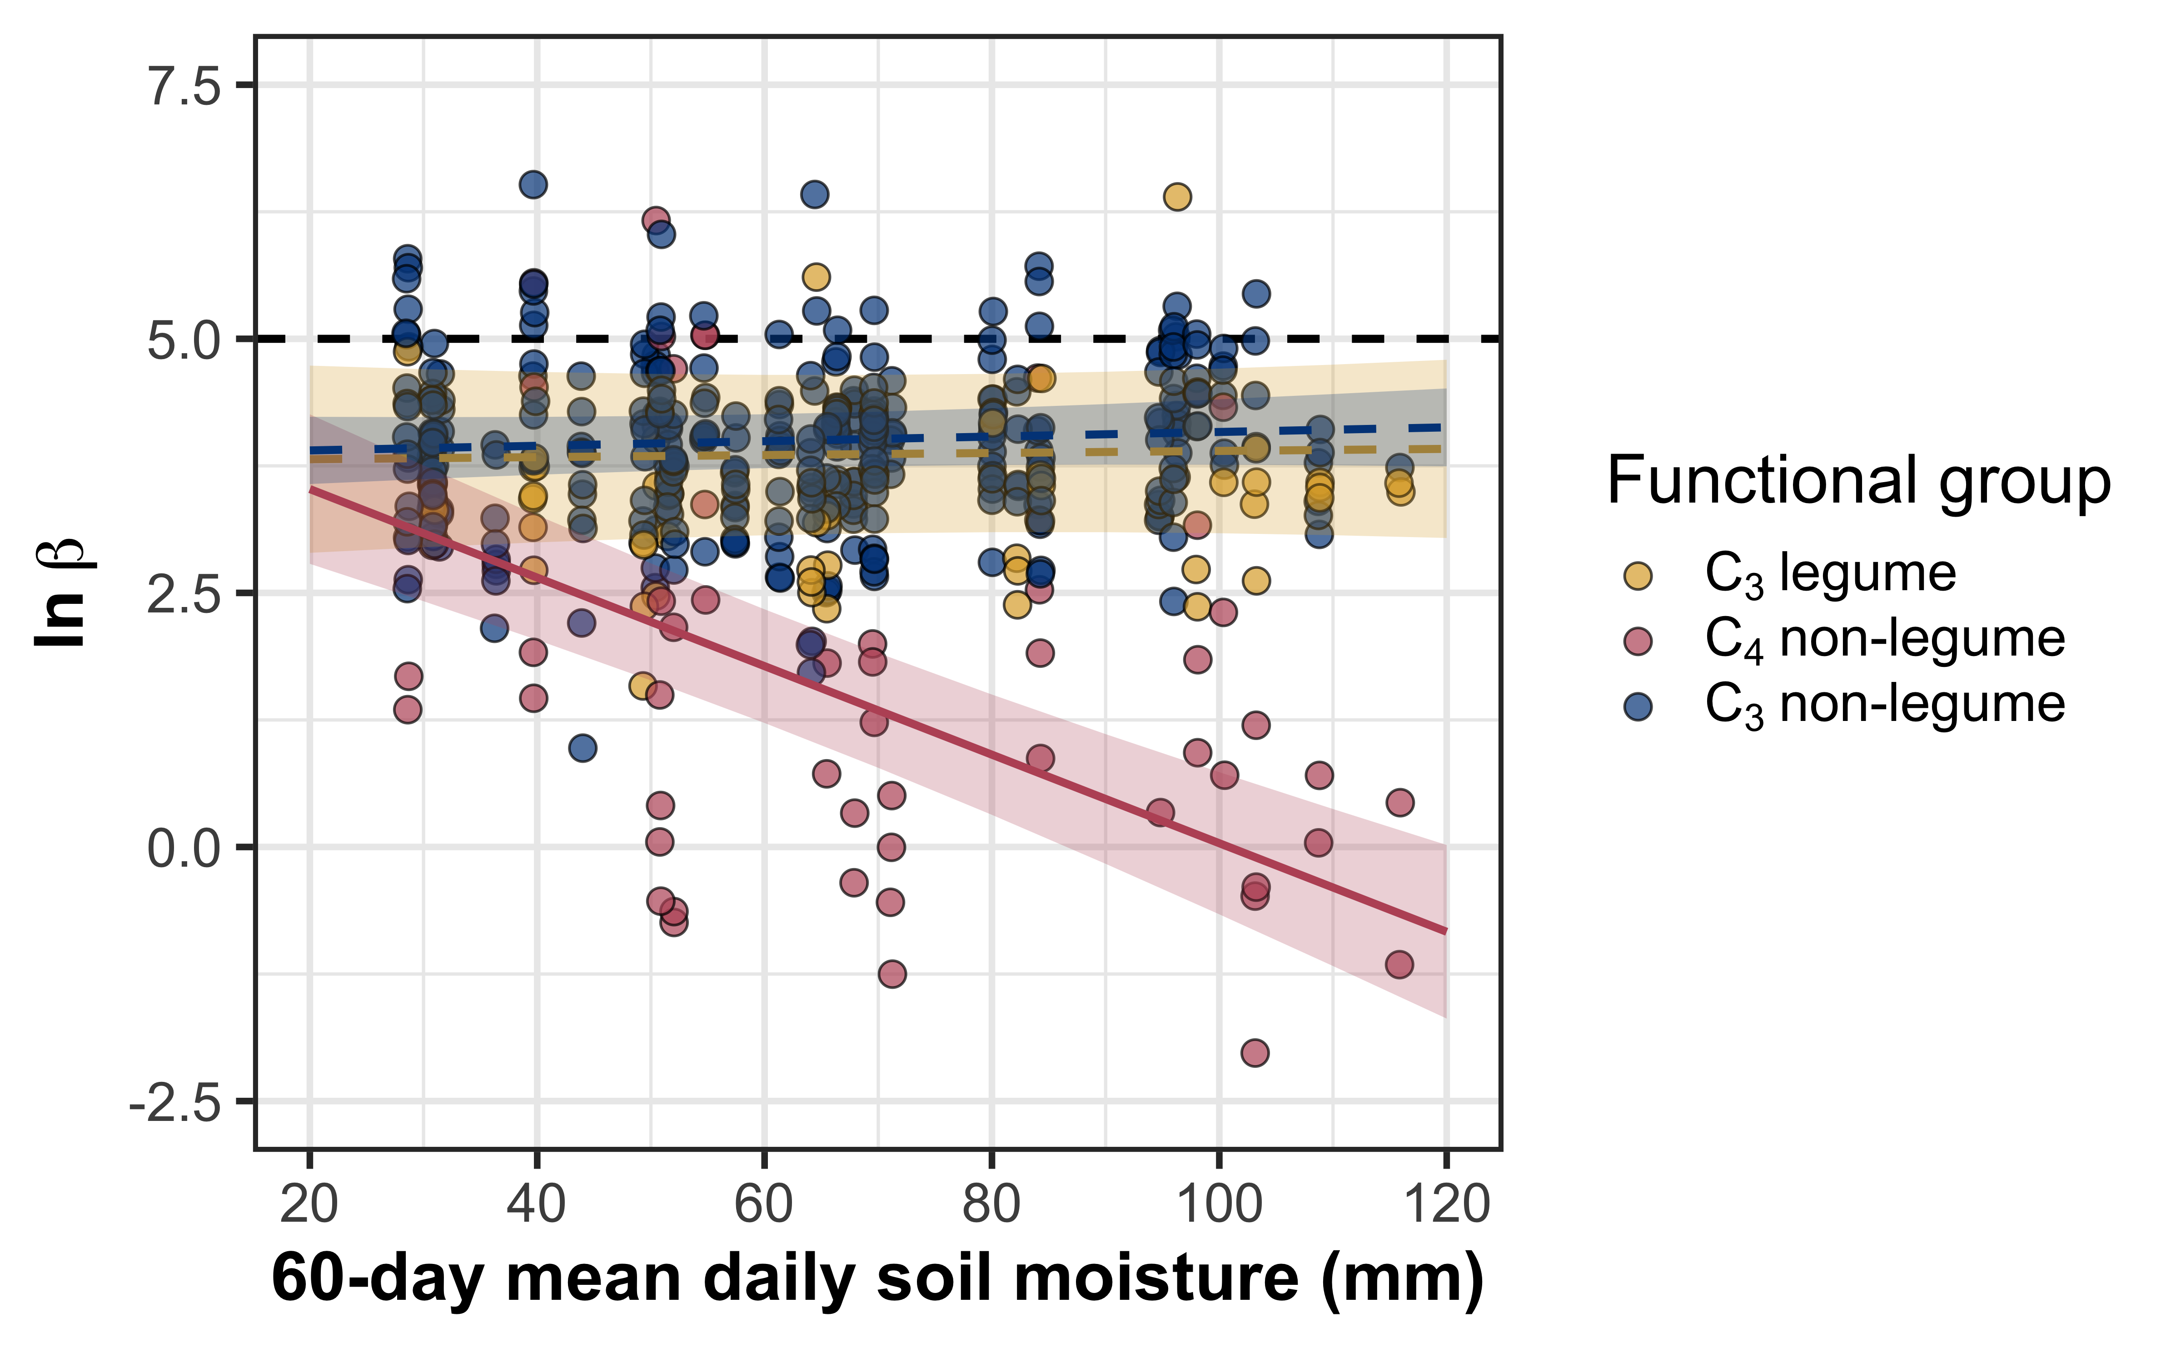
Soil moisture does not change the net cost of resource acquisition across species, except in C₄ non-legumes
Net cost of
resource acquisition
@EvanPerkowski

Slide 18
Soil resource availability
H₂O
Net cost of resource acquisition
H₂O
Water use efficiency
Leaf nitrogen
N
N
N
@EvanPerkowski

Slide 19
Soil resource availability
H₂O
Net cost of resource acquisition
H₂O
Water use efficiency
Leaf nitrogen
N
N
N
@EvanPerkowski

Slide 20
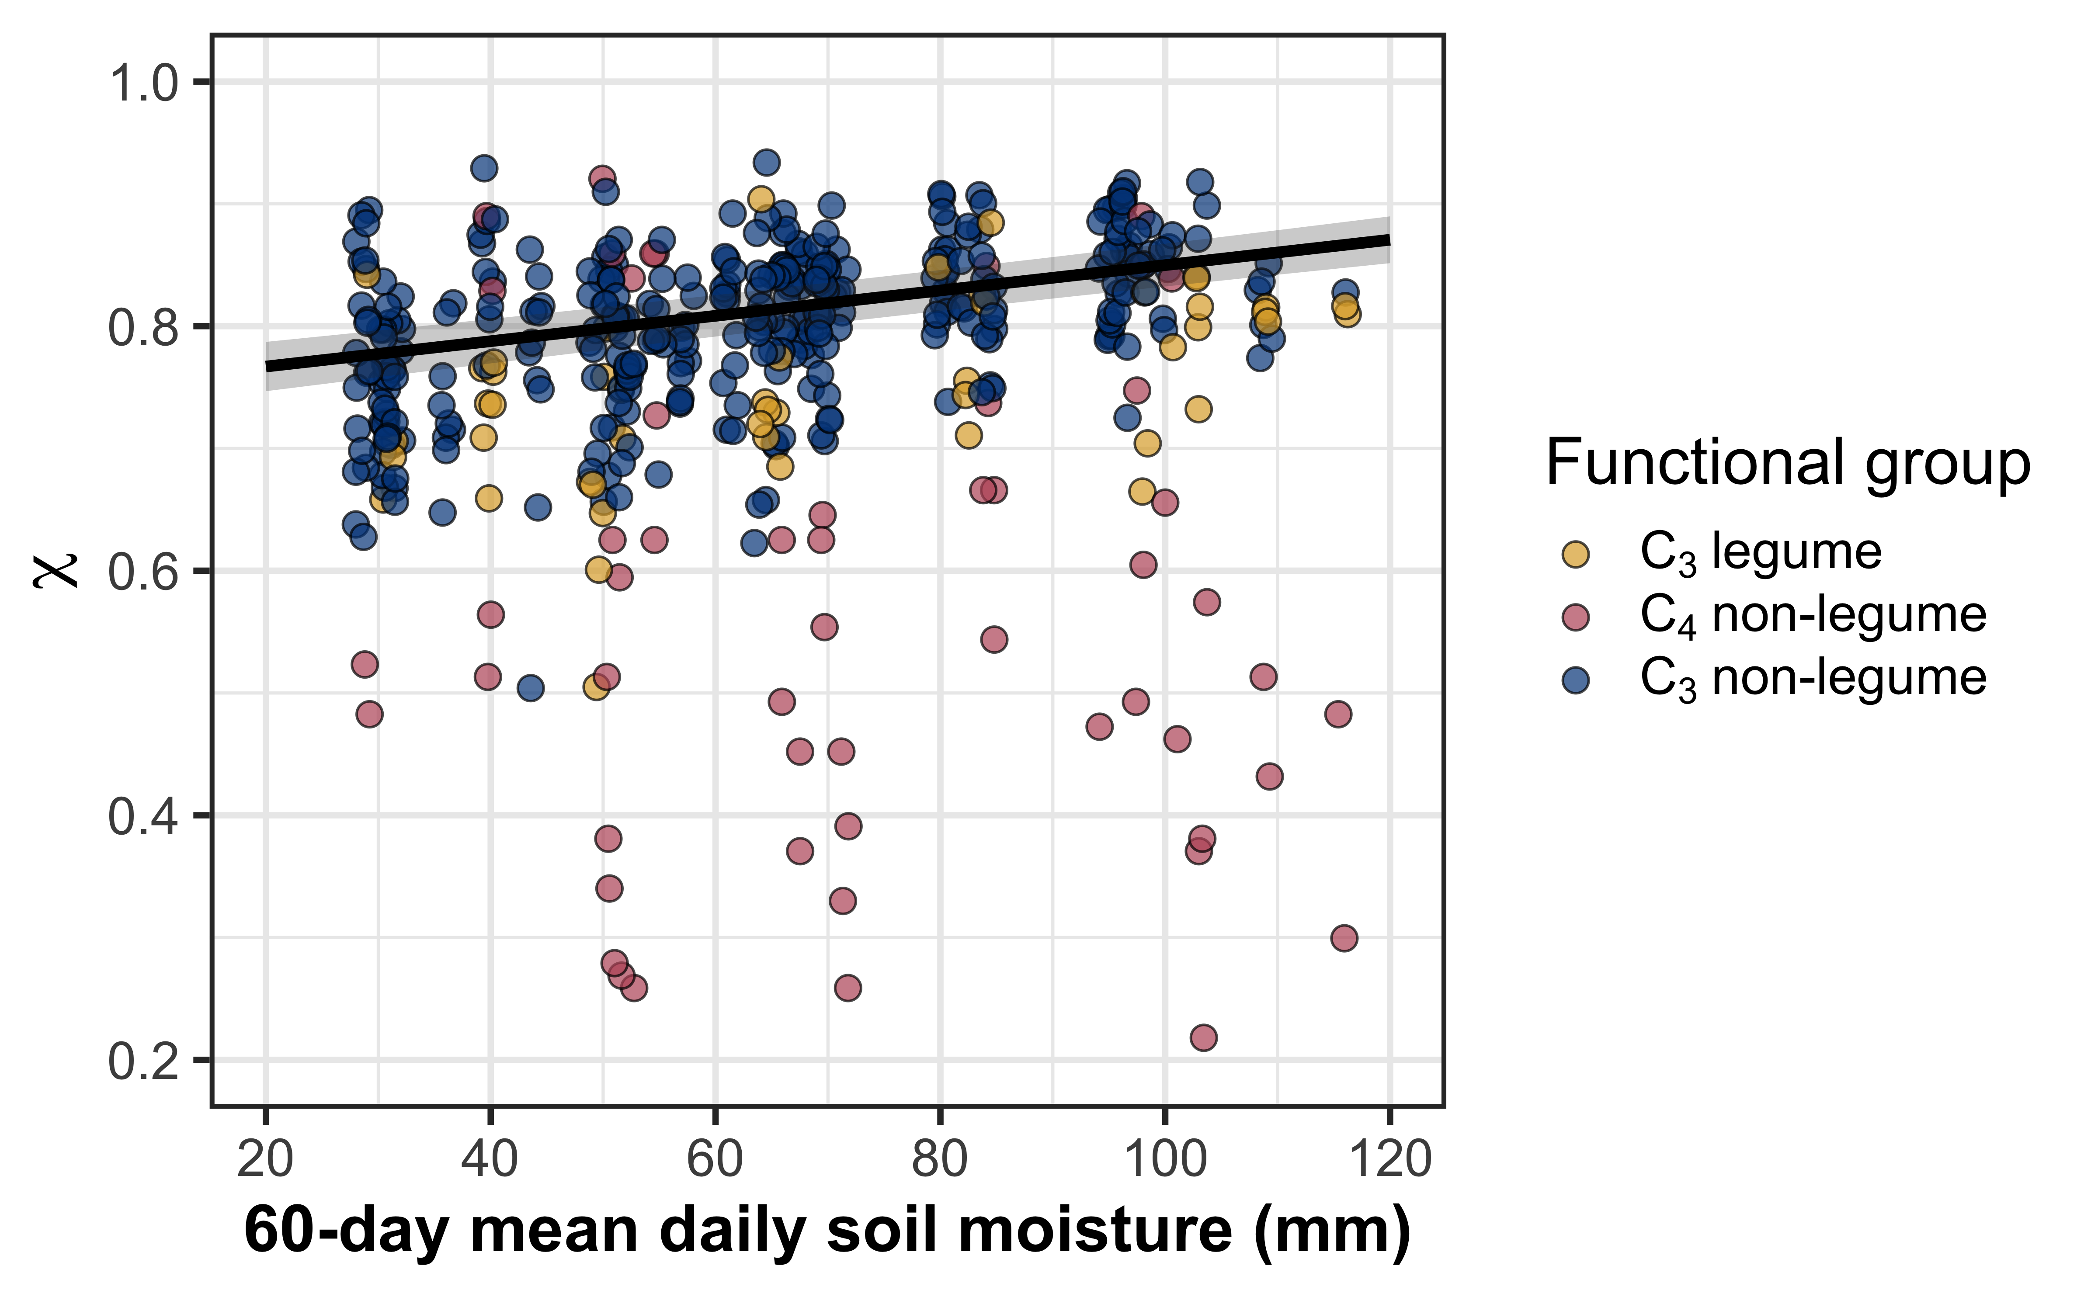
Increasing soil moisture decreases water use efficiency
@EvanPerkowski

Slide 21
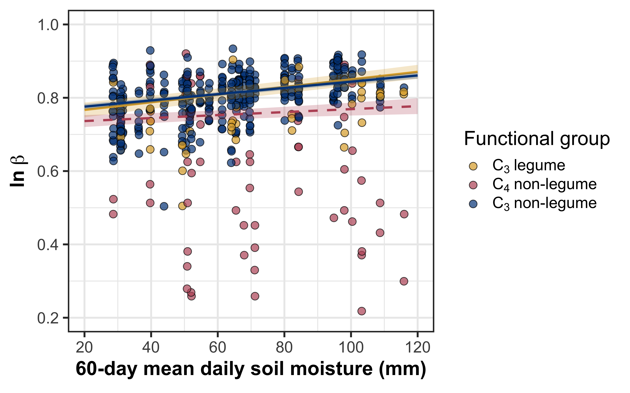
Increasing soil moisture decreases water use efficiency, a pattern observed across all PFTs
@EvanPerkowski

Slide 22
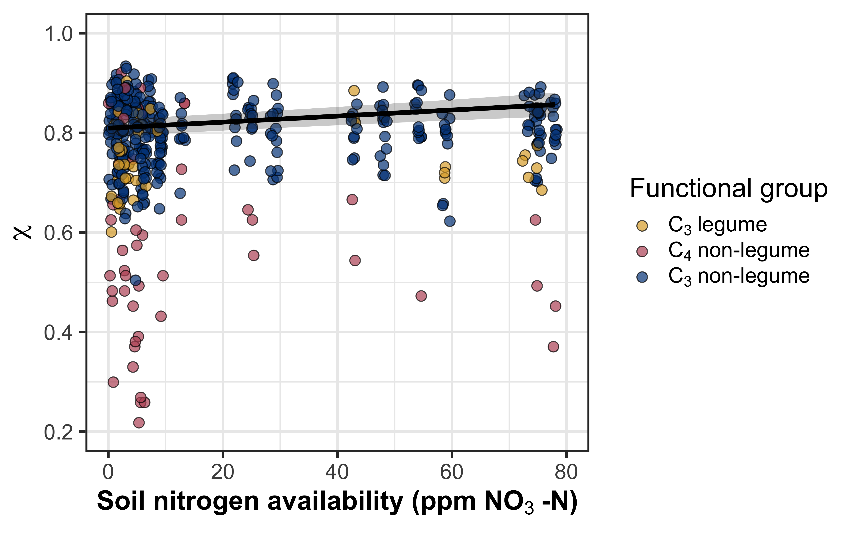
Soil nitrogen availability decreases water use efficiency
@EvanPerkowski

Slide 23
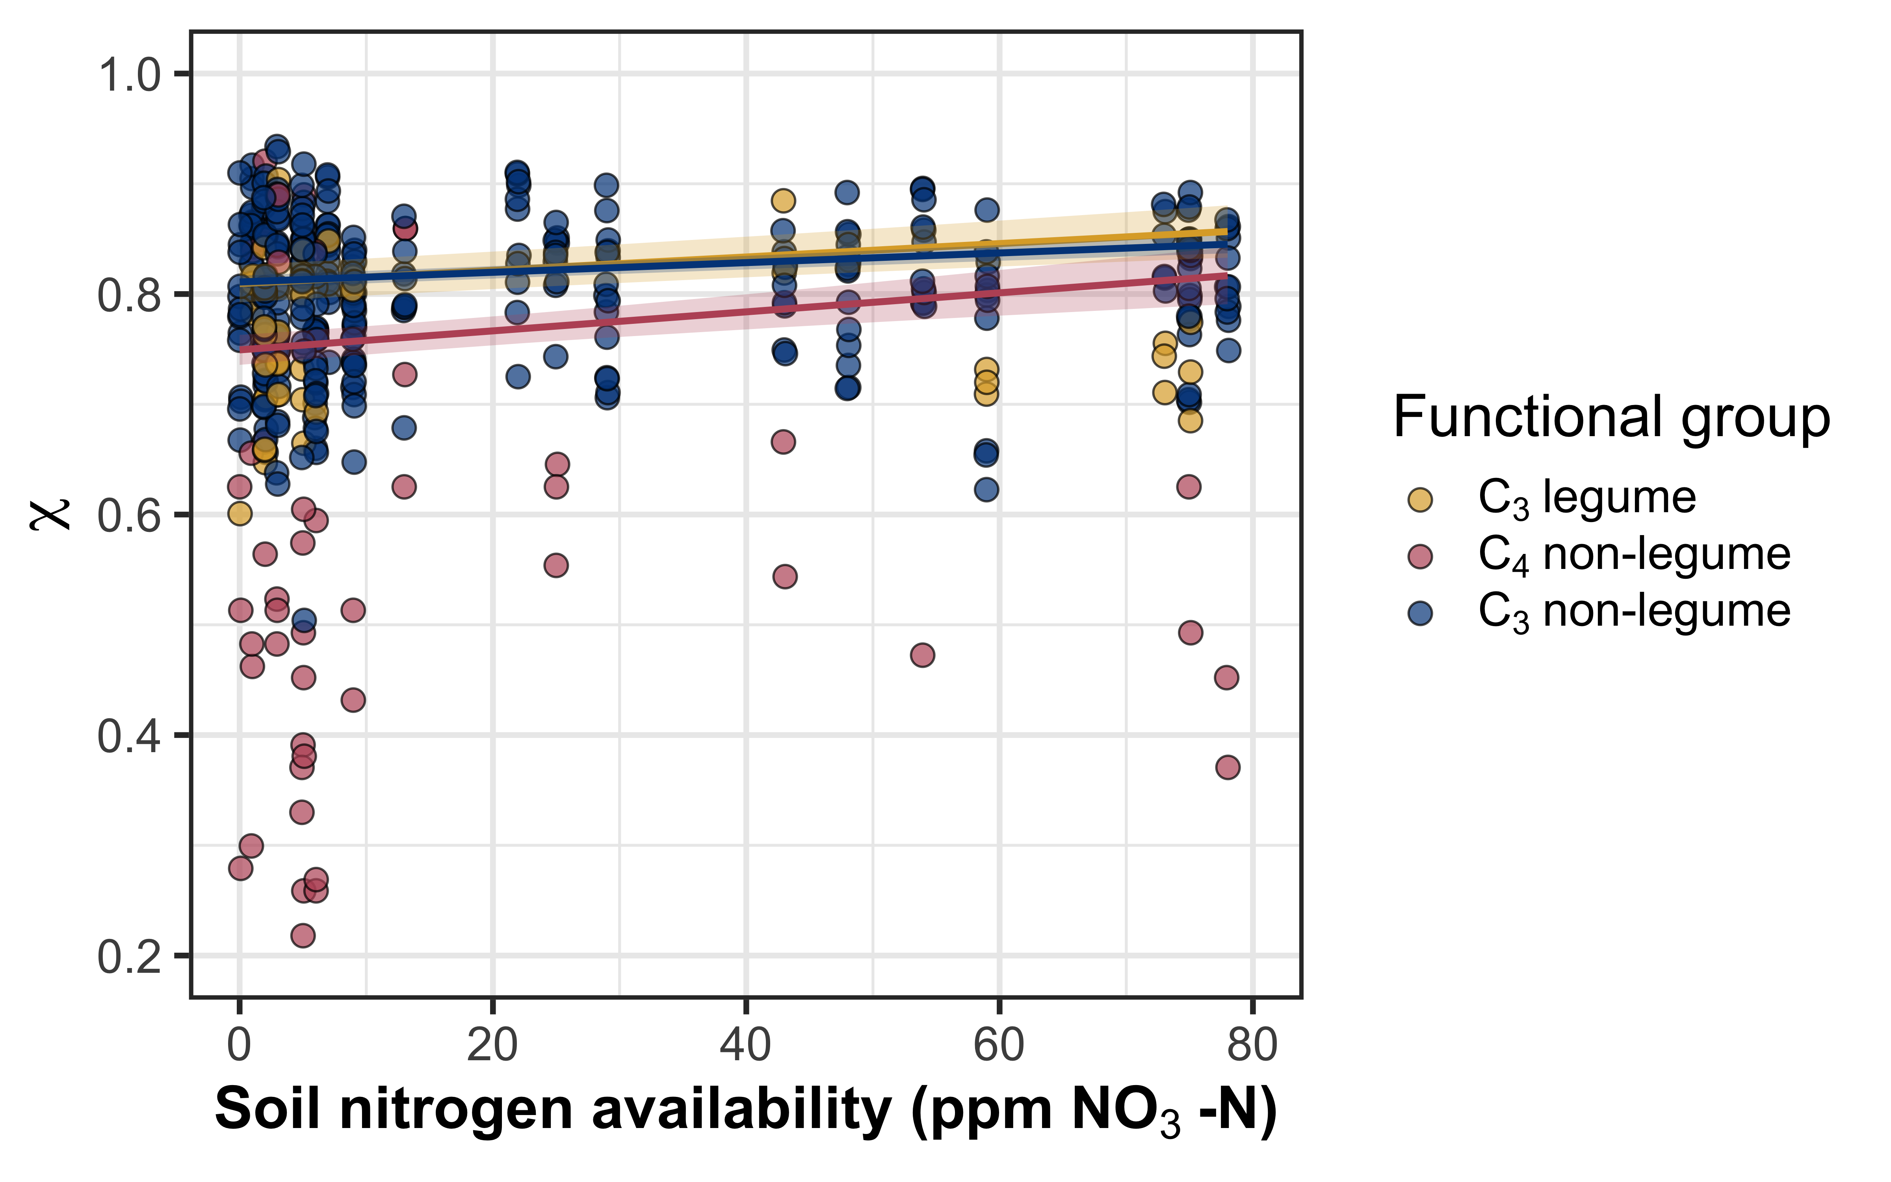
Soil nitrogen availability decreases water use efficiency, a pattern observed across all PFTs
@EvanPerkowski

Slide 24
Soil resource availability
H₂O
Net cost of resource acquisition
H₂O
Water use efficiency
Leaf nitrogen
N
N
N
@EvanPerkowski

Slide 25
Soil resource availability
H₂O
Net cost of resource acquisition
H₂O
Water use efficiency
Leaf nitrogen
N
N
N
@EvanPerkowski

Slide 26
Soil resource availability
H₂O
Net cost of resource acquisition
H₂O
Water use efficiency
Leaf nitrogen
N
N
N
@EvanPerkowski

Slide 27
Soil resource availability
H₂O
Net cost of resource acquisition
H₂O
Water use efficiency
Leaf nitrogen
N
N
N
@EvanPerkowski

Slide 28
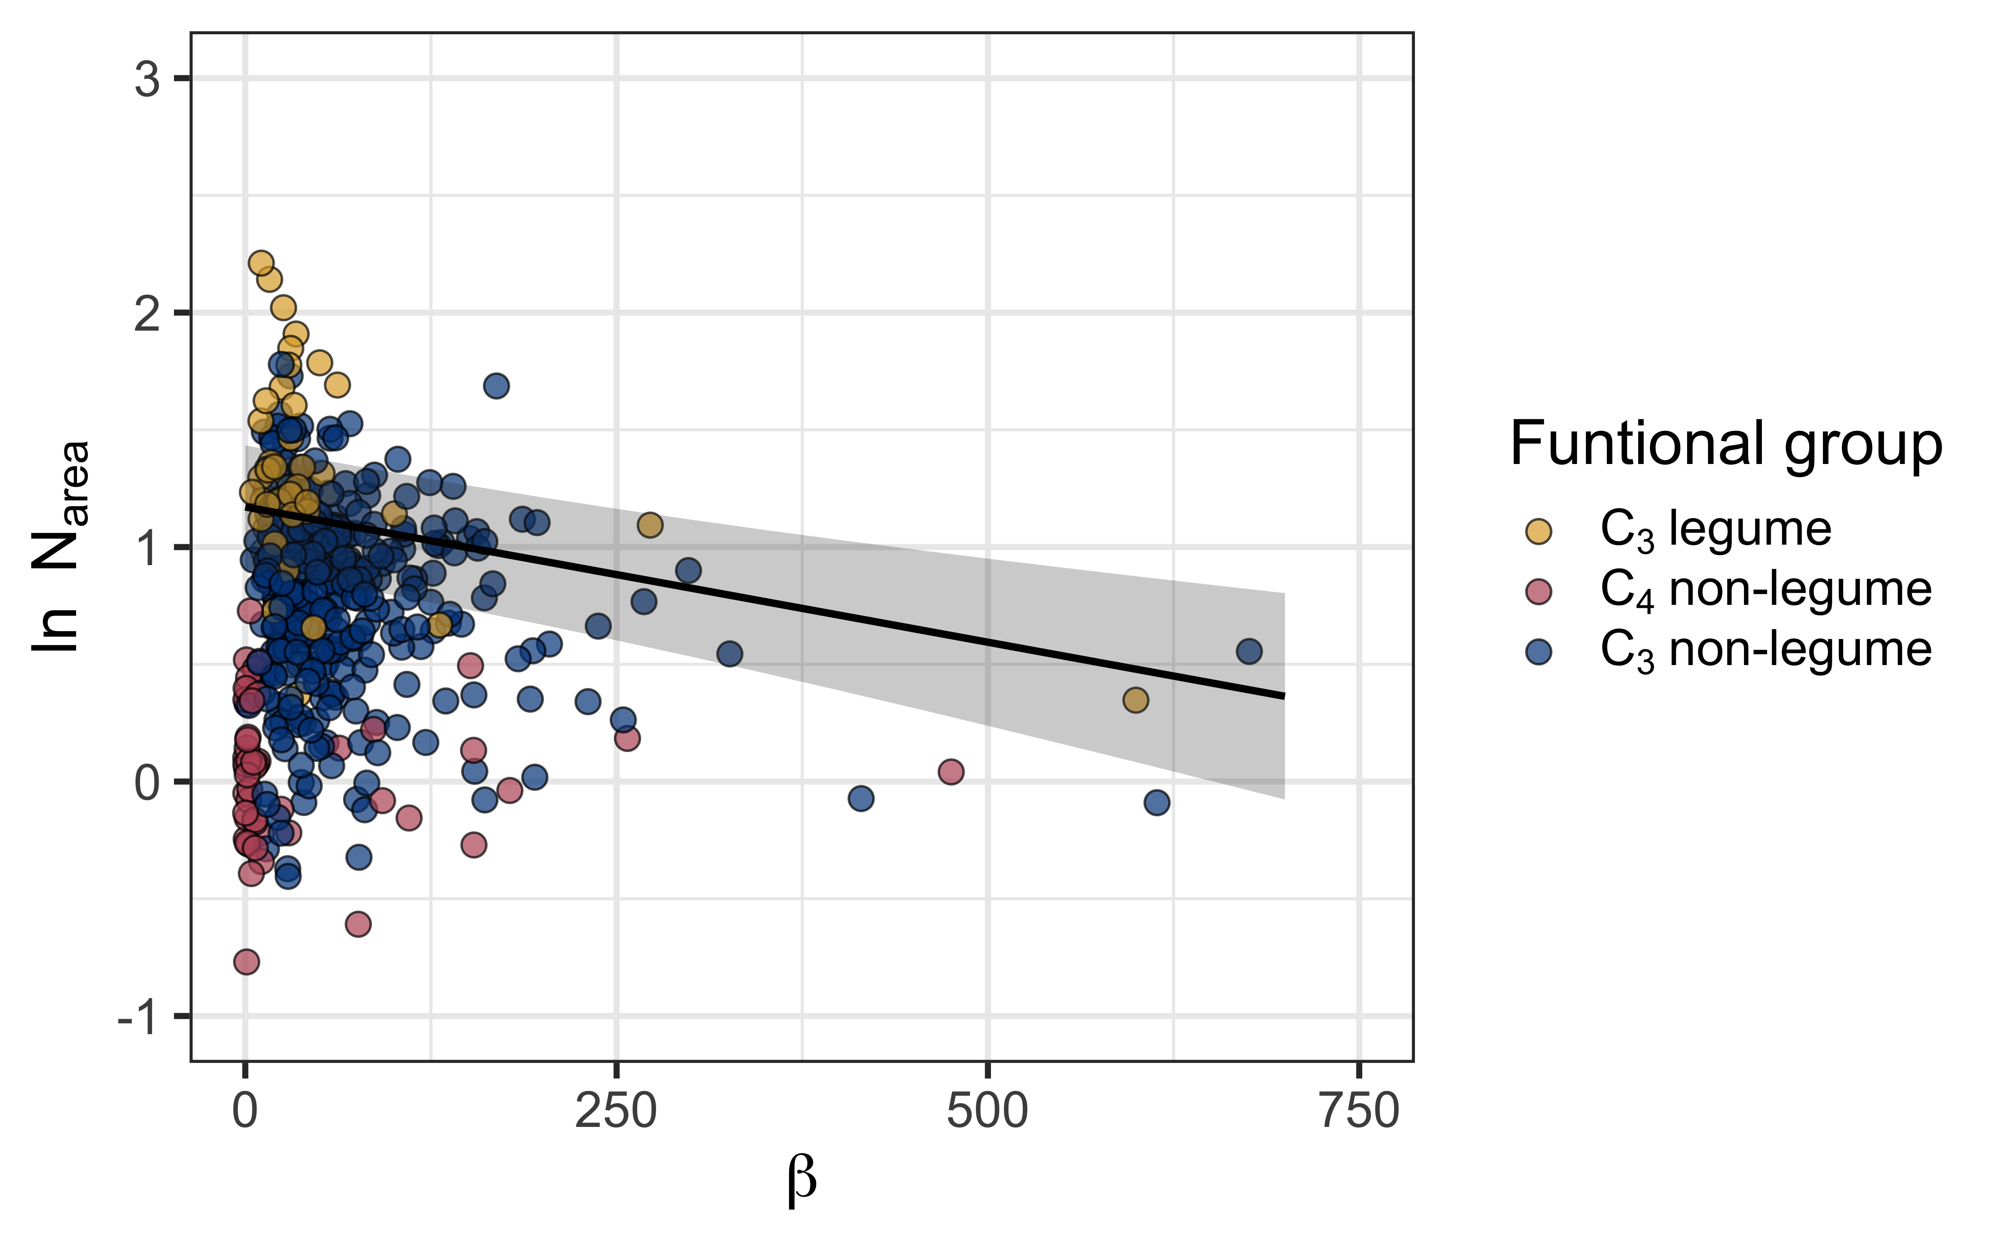
Increasing net costs of resource use generally decrease leaf nitrogen
@EvanPerkowski

Slide 29
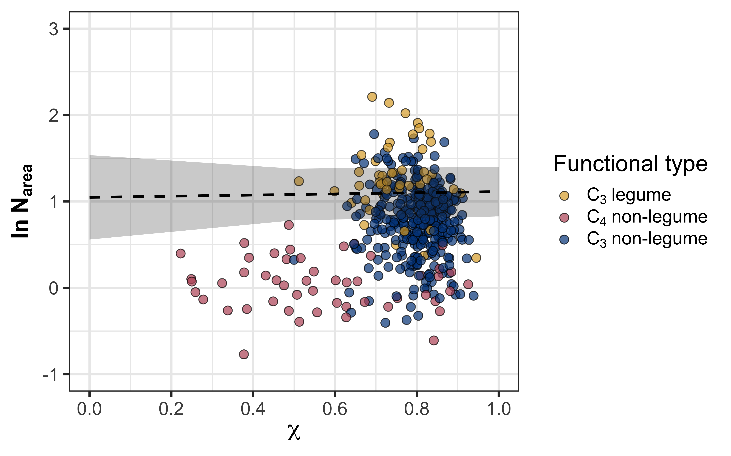
Water use efficiency does not change leaf nitrogen
@EvanPerkowski

Slide 30
Soil resource availability
H₂O
Net cost of resource acquisition
H₂O
Water use efficiency
Leaf nitrogen
N
N
N
@EvanPerkowski

Slide 31
Soil resource availability
H₂O
Net cost of resource acquisition
H₂O
Water use efficiency
Leaf nitrogen
N
N
N
@EvanPerkowski

Slide 32
Soil resource availability
H₂O
Net cost of resource acquisition
H₂O
Water use efficiency
Leaf nitrogen
N
N
N
@EvanPerkowski

Slide 33
Soil resource availability
H₂O
Net cost of resource acquisition
H₂O
Water use efficiency
Leaf nitrogen
N
N
N
@EvanPerkowski

Slide 34
Soil resource availability
H₂O
Net cost of resource acquisition
H₂O
Water use efficiency
Leaf nitrogen
N
N
N
@EvanPerkowski

Slide 35
Soil resource availability
H₂O
Net cost of resource acquisition
H₂O
Water use efficiency
Leaf nitrogen
N
N
N
@EvanPerkowski

Slide 36
Soil resource availability
H₂O
Net cost of resource acquisition
H₂O
Water use efficiency
Leaf nitrogen
N
N
N
@EvanPerkowski

Slide 37
Soil resource availability
H₂O
Net cost of resource acquisition
H₂O
Water use efficiency
Leaf nitrogen
N
N
N
@EvanPerkowski

Slide 38

Acknowledgements
Risa McNellis
Jorge Ochoa
Peter Eludini
Christine Vanginault
Abigail Bell
Jose Villeda
Hannah German
Avery Schoenherr
@EvanPerkowski

Slide 39

Thank you!
Slides available at [insert URL here]
@EvanPerkowski

Slide 40
Extra slides

Slide 41
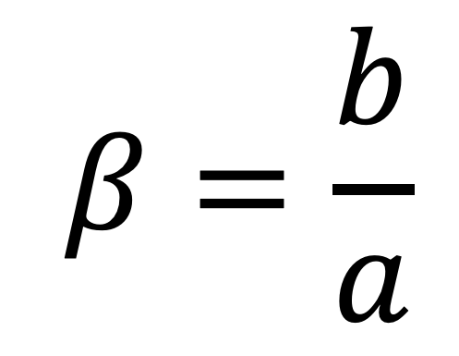
Resource unit cost ratio (β)
cost of acquiring and using N
$$β=\frac{b}{a}$$
cost of acquiring and using H₂O

Slide 42
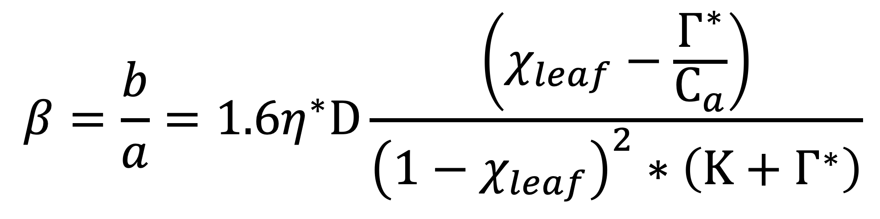
Resource unit cost ratio (β)
$$β=\frac{b}{a}=1.6η^{∗}D\frac{\left(χ_{leaf}−\frac{Γ^{∗}}{C_{a}}\right)}{{\left(1−χ_{leaf}\right)}^{2}∗\left(Κ+Γ^{∗}\right)}$$
Notes:
We used the following field manipulation experiment to investigate whether changes in soil resource availability influenced leaf quantity/quality tradeoffs or water/nitrogen use tradeoffs.
Starting in 2010, our coauthor Christy Goodale set up a full-factorial nitrogen-by-sulfur field manipulation experiment at three sites in a contiguous closed canopy forest all within a 20-km radius of Ithaca, New York
This experiment was originally created to tease apart the impacts of soil pH change and soil nitrogen fertilization on forest ecosystem functions;
however, because sulfur additions acidify the soil and promote nitrogen losses over time, this system provides a unique soil nitrogen availability gradient to test our hypotheses

